Slide 1
Predictive Maintenance : Encoder Data Project
Karishma Manohar

Slide 2
Problem Description
The major problems faced by the industries are the maintenance of the machines. Especially to each industry a specific part or the entire machine plays a major role and is substantial as well. While we understand the importance of the scanners in any aircraft, in a short note let us understand what it does and what consequences the company has to face due to the failure of the same.
Firstly, the scanners help us to detect the programming of a particular LED light pulsating into the window barrier.
Secondly the barriers in them help us to find the subsequent calculation and also represent the rotation of a component.
Thirdly the barrier gives codes as err(error value) and errf ( error filtered value) to find out whether the LED lights are functioning well or needs a check for a speedy maintenance issue or whether no maintenance is needed.
Note :
We consider any err(error value) > or = to 12 % to be in the stage of maintenance or failure
We consider any errf (error filtered value) > or = to 0.5 to be in the stage of maintenance or failure.

Slide 3


Preventive Measures and a figure to explain the exact position of the scanner
How to identify a failure
How to prevent the failure
When can we expect a scanner to go ahead with the maintenance service
How can we cut cost on this unexpected failures and maintenance.
Note: The highlighted area shows the LED lights near the window barrier.

Slide 4
Identifying a Failure
We aware that the err and errf values help us with the error of the encoder component from the dataset provided.
We will have consider here that the dataset totally has 2752 rows and 11 columns. Which means it is easily understandable that we have 2752 scanners.
But well, here is the challenge, considering the understanding of the dataset, was able to figure out that there are totally 73 scanners in total which show repetitiveness according to the date and time.
With the continuous err and errf values for a particular scanner, we will be able to detect the possibility of the failure.
For eg:
Found out that the scanner-H173 shows the err and errf values from the year 2017 December 17th and is continued to the following year 2018 March 6th . Considering this a constant err and errf values for a longer period may cause the scanner to fail.

Slide 5
Identifying a Failure
From the given dataset , 7 scanners were founded with the err > = 12% values. Fig :1 could explain.
Scanner K 250 has the highest of all at a range of 200.01 err value.
The same does not match with errf values > = 0.50 values. Fig :2 could explain
The scanners, H162, H163,H161,H153 does not show up in the Fig: 1 since the errf values and err values are not correlated.
They have to be handled individually and check on the err and errf values and take necessary action.
Fig: 1
Fig: 2
scanner | min | max | err | pixels | minf | maxf | errf
K250 | -1 | 36017 | 200.01 | 17 | -1 | 35707 | 200.01
H152 | 29649 | 41793 | 34 | 15 | 35693 | 35789 | 0.27
H152 | 29600 | 41809 | 34.19 | 15 | 35683 | 35804 | 0.34
K150 | 33509 | 37801 | 12.04 | 18 | 35708 | 35726 | 0.05
K150 | 33509 | 37792 | 12.01 | 18 | 35709 | 35725 | 0.04
K150 | 33478 | 37815 | 12.17 | 21 | 35707 | 35728 | 0.06
K150 | 27443 | 43960 | 46.26 | 34 | 35708 | 35727 | 0.05
K150 | 27443 | 43960 | 46.26 | 34 | 35708 | 35727 | 0.05
scanner | min | max | err | pixels | minf | maxf | errf
H162 | 44521 | 45766 | 2.76 | 36 | 44824 | 45424 | 1.33
H163 | 45275 | 46775 | 3.26 | 59 | 45695 | 46323 | 1.36
K250 | -1 | 36017 | 200.01 | 17 | -1 | 35707 | 200.01
H161 | 45136 | 47057 | 4.17 | 20 | 45717 | 46344 | 1.36
H153 | 44909 | 46444 | 3.36 | 67 | 45498 | 46121 | 1.36

Slide 6
Preventive measures for the failure
As we can find out that both err and the errf values plays a substantial role in the programming of the scanner, we need to take preventive steps to handle this.
With the use of algorithms , henceforth we can get a track on all the scanners , on when and how a scanner will work and the time for the same to be given for a service before even we could expect a failure .
With the algorithms we can also figure out the number of scanners working perfectly fine and also detect in between the err and errf values to predict the same.
This would also help us on cost cut to the organization for the maintenance and sudden unexpected failure expenses.

Slide 7
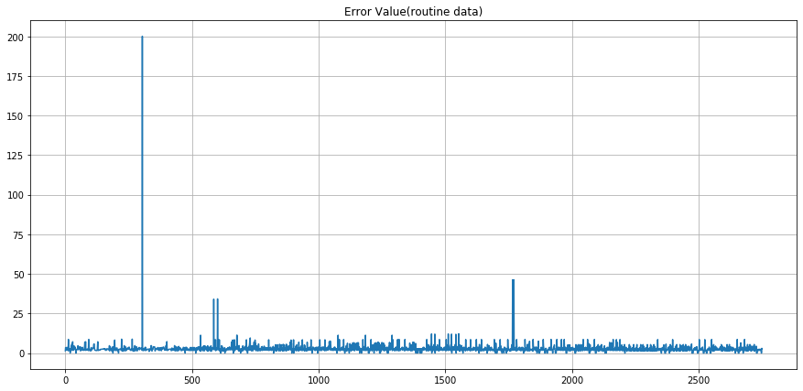
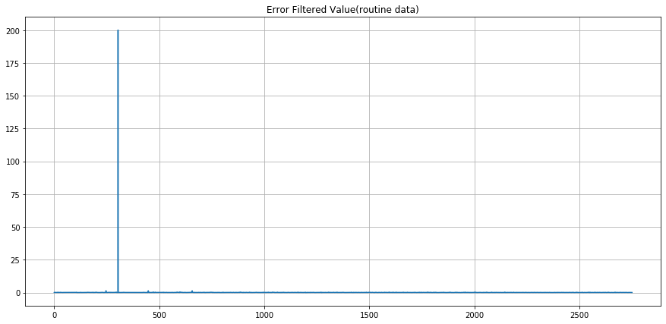
Understanding the error values
The figure :1 below shows the variation of the err value in between 0-200 and a random count of the scanners.
The figure :2 shows the variation of the errf value 0-200 and a random count of the scanners . We are also able to see that there is one value in err and errf at 200th point.
Note: The figure does not include the repetitive number of the scanners.
Fig :1 Fig :2

Slide 8
Algorithmic Approach
Taking into account that the dataset is not a linear one since the err and errf values do not correlate, we have considered the dataset to be fit into three major algorithms, which gives us three different accuracy .
The three algorithms are as follows, and will also be explaining why was a perfect pick done on the final algorithm.

Slide 9
Decision Tree Model
Pros of Decision Tree
This algorithm is a quiet easy one to be approached and gives a clear vision of the accuracy in a tree format as it’s name is.
Each branch of the tree represents the outcome of the test sample
It is also considered to be one of the best algorithms to be used in supervised learning methods.
We use this to also predict for a medium sized dataset where we can expect the accuracy to be accurately given.

Slide 10
Decision Tree Accuracy
The scores are been taken for 3 number set of samples.10,20 and 25.From the below figure, we can understand the impact of the algorithm in each classification score.
We can also figure out that the accuracy score is the same and isn’t giving much appreciable score.
Accuracy Score for 10 Samples | Accuracy Score for 20 samples | Accuracy Score for for max 25 samples
0.96 | 0.96 | 0.96
Precision Value
Macro Avrg Weighted Avg
0.94 0.98

Slide 11
Decision Tree Accuracy
From the scores below, we able to find that the accuracy score for all the 3
samples are same.
The Cross Validation Mean and variance seems to be on a good number for the CV for 20 samples .
For AM=0.88 and AV=0.012, considering the variance to be the lowest.
Cross Validation Accuracy for 10 samples | Cross Validation Accuracy for 20 samples | Cross Validation Accuracy for max 25 samples
Accuracy Mean Accuracy Variance | Accuracy Mean Accuracy Variance | Accuracy Mean Accuracy Variance
0.84 0.079 | 0.88 0.012 | 0.87 0.020
Recall Value
Macro Avrg Weighted Avg
0.91 0.96

Slide 12
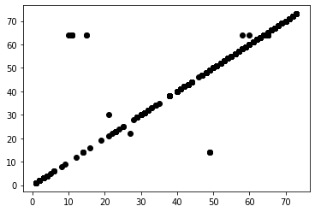
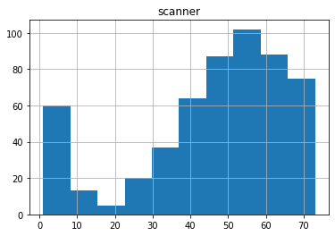
Decision Tree Diagrammatic Understanding
Fig :1 represents the out come of the actual scanners and the predicted ones.It also shows us
the outliers as well.
Fig: 2 Represents the actual numbers of the scanners.
Note: The diagram represents the after tested results.
Fig :1
Fig :2

Slide 13
Cons of Decision Tree
Decision Tree has it’s own limitation towards getting overfitted.
Due to this we may not be able to expect an accurate accuracy for a particular dataset .
It is not to be considered if the dataset is huge and expecting to predict a right output .
Hence we have not used Decision Tree in this dataset.

Slide 14
Random Forest
In the Decision Tree model, we create multiple trees until we get the accuracy and 0 error.
In receipt of this we classify the data into different bags (tests) and derive the solution with the highest number given as the output.
The process of segregating the sets of the given data into smaller tree and deriving the accuracy is called ‘Bagging’. To perform this technique for a better accuracy we go ahead with Random Forest model.
It also handles overfitting of a dataset.

Slide 15
Random Forest Accuracy
The scores are been taken for 3 number set of samples.10,20 and 25.From the below figure, we can understand the impact of the algorithm in each score.
We can also figure out that the accuracy score is the same for all the 3 samples . But in random
Forest the precision value is less comparing the Decision Tree’s Precision Value which was 0.94 and 0.98 respectively.
Accuracy Score for 10 Samples | Accuracy Score for 20 samples | Accuracy Score for for max 25 samples
0.96 | 0.96 | 0.96
Precision Value
Macro Avrg Weighted Avg
0.93 0.97

Slide 16
Random Forest Accuracy
Comparing Decision Tree model, this one gives a good accuracy when we try it on the maximum number of samples at 0.93.
The Cross Validation accuracy is also much into the 90. values for the 20 and 25 samples test.
The lowest accuracy with the variance is the first sample of 10,For AM=0.88 and AV=0.066.
We considered this model when we find out that the Precision and Recall value is less. But we are able to see that Decision Tree has a better value of both as,0.91 &0.96 as RV and 0.94 & 0.98 as PV.
Cross Validation Accuracy for 10 samples | Cross Validation Accuracy for 20 samples | Cross Validation Accuracy for max 25 samples
Accuracy Mean Accuracy Variance | Accuracy Mean. Accuracy Variance | Accuracy Mean Accuracy Variance
0.88 0.066 | 0.92 0.085 | 0.93 0.080
Recall Value
Macro Avg Weighted Avg
0.92 0.96

Slide 17
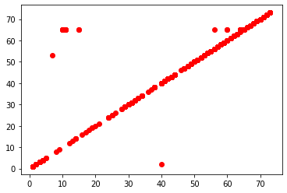
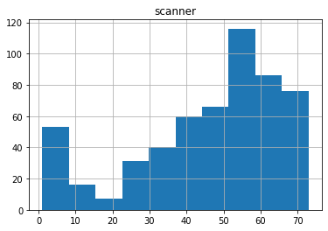
Random Forest Diagrammatic Understanding
Fig :1 represents the out come of the actual scanners and the predicted ones. It also shows us the outliers as well.
Fig: 2 Represents the actual numbers of the scanners.
Note: The diagram represents the after tested results.
Fig: 1
Fig: 2

Slide 18
Cons of Random Forest
It consumes a good portion of our time to construct a Decision tree and detect the outputs.
It is more complex as it gives us a very good results when tried with medium sized dataset but with huge ones it will not improve the accuracy
Hence we have not considered this model to help us with the exact outputs.

Slide 19
Gradient Boosting
We usually take 20 % or 80 % for a particular sample to be trained.
This Gradient boosting boosts the sample even more by splitting the data set in to 80% and 20% again and tests the same for a prefect accuracy.
We try to keep building the tree model until we get a 95% accuracy and the error value to be 0.
Hence we have predicted the results using Gradient Boosting.

Slide 20
Gradient Boosting Accuracy
The scores are been taken for 3 number set of samples.10,20 and 25.From the below figure, we can understand the impact of the algorithm in each score.
We found out that the accuracy score for the 10 and 20 samples are 0.97 respectively and for 25 samples is 0.96 respectively, which is the highest comparing both the previous models used.
The Precision value is also at a good value of 0.93 and 0.98.
Accuracy Score for 10 Samples | Accuracy Score for 20 samples | Accuracy Score for max 25 samples
0.97 | 0.97 | 0.96
Precision Value
Macro Avrg Weighted Avg
0.93 0.98

Slide 21
Gradient Boosting Accuracy
This model has given the perfect accuracy score of 0.97 being the highest comparing the other models.
Considering the max samples tested of 25, this model gives us the accurate mean and variance of 0.85 & 0.22, which is also slightly comparative to the values taken from Decision tree of 0.87 & 0.20.
The recall value also is comparatively accurate at 0.94 & 0.97 being the highest as well.
Cross Validation Accuracy for 10 samples | Cross Validation Accuracy for 20 samples | Cross Validation Accuracy for max 25 samples
Accuracy Mean Accuracy Variance | Accuracy Mean Accuracy Variance | Accuracy Mean Accuracy Variance
0.83 0.049 | 0.86 0.013 | 0.85 0.022
Recall Value
Macro Avrg Weighted Avg
0.94 0.97

Slide 22
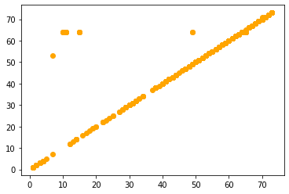
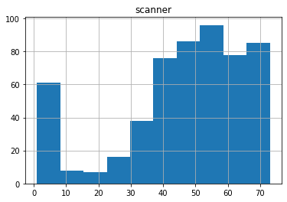
Gradient Boosting Diagrammatic Understanding
Fig :1 represents the out come of the actual scanners and the predicted ones. It also shows us the outliers as well.
Fig: 2 Represents the actual numbers of the scanners.
Note: The diagram represents the after tested results.
Fig: 1 Fig :2

Slide 23
Results
From all the testing and training using the models, the conclusion of the number of scanners could fail in the very near future is predicted.
We also admit that the results are taken as per the data provided and according to the prediction algorithmic values.
We have used 3 models to predict the accuracies. The best fit model which gave the accuracy was Gradient boosting, with it’s recall value at 0.94 & 0.97,Precision value at 0.93 & 0.98.
Cross Validation scores above 0.95 tested on the sample numbers of 10 and 20.

Slide 24
Name of Scanners to be failed
The total number of scanners which could possible fail is 21.
The possibilities are based on their err and errf values repeated according to the date and time.
The names are given below.
S.No | Scanner
1 | H173
2 | H127
3 | K115
4 | H161
5 | H174
6 | H128
7 | K141
S.No | Scanner
8 | K169
9 | K172
10 | K237
11 | K114
12 | H162
13 | H130
14 | K150
S.No | Scanner
15 | K120
16 | K168
17 | K218
18 | K208
19 | K220
20 | H163
21 | K171

